Slide 1

AFFLUENCE FASHION LIMITED. IS ONE OF THELEADING FASHION BUYING HOUSE IN BANGLADESH.

Slide 2
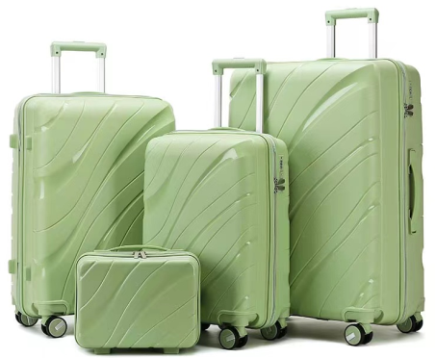
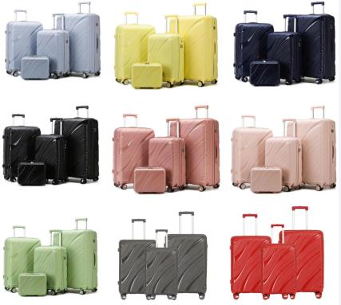
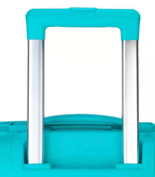
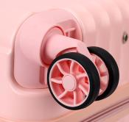
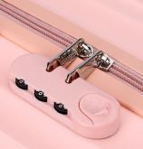

EPP-228
PP LUGGAGE COLLECTION
14IN//20IN//24IN/28IN
Color matching accessories
Iron trolley
Premium No. 8 Single Zipper
common lock
Silent wheels
210D thicken lining
MOQ: 600 sets

Slide 3
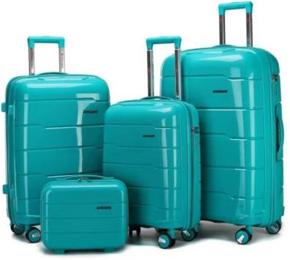
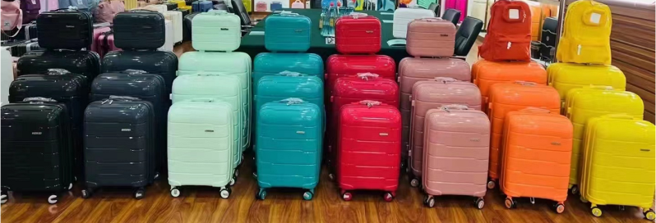
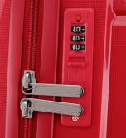
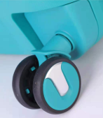

EPP-227
PP LUGGAGE COLLECTION
14IN//20IN//24IN/28IN
Color matching accessories
Iron trolley
Premium No. 8 Single Zipper
Built-in lock
Silent wheels
210D thicken lining
MOQ: 600 sets

Slide 4
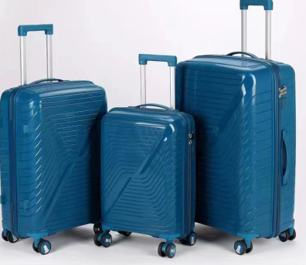
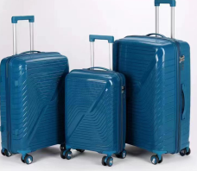
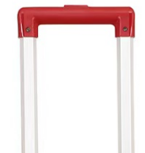

EPP-1158
PP LUGGAGE COLLECTION
14IN//20IN//24IN/28IN
Color matching accessories
Iron trolley
Premium No. 8 Single Zipper
Built-in lock
Silent wheels
210D thicken lining
MOQ: 600 sets

Slide 5
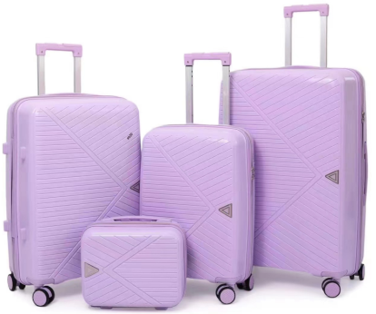
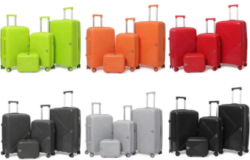
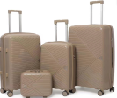
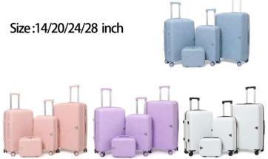
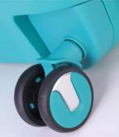
EPP-1025
PP LUGGAGE COLLECTION
14IN//20IN//24IN/28IN
Color matching accessories
Iron trolley
Premium No. 8 Single Zipper
Built-in lock
Silent wheels
210D thicken lining
MOQ: 600 sets

Slide 6
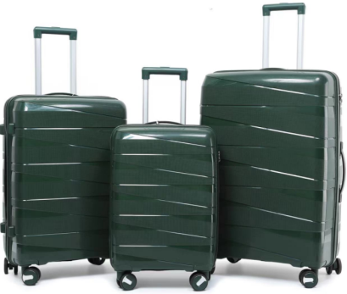
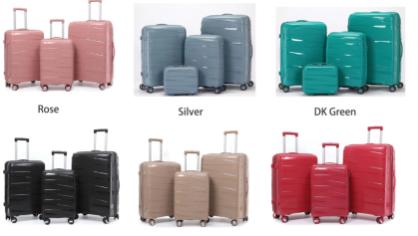
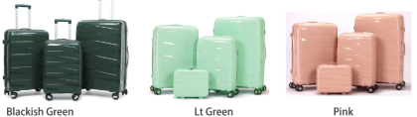
EPP-1288
PP LUGGAGE COLLECTION
14IN//20IN//24IN/28IN
Color matching accessories
Iron trolley
Premium No. 8 Single Zipper
Built-in lock
Silent wheels
210D thicken lining
MOQ: 600 sets

Slide 7
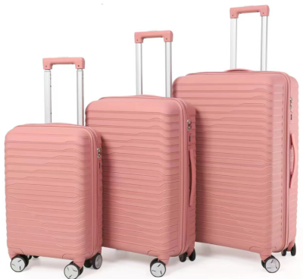
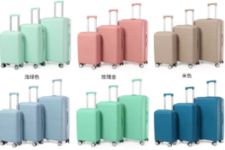
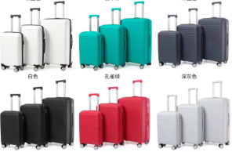
EPP-1289
PP LUGGAGE COLLECTION
14IN//20IN//24IN/28IN
Color matching accessories
Iron trolley
Premium No. 8 Single Zipper
Built-in lock
Silent wheels
210D thicken lining
MOQ: 600 sets

Slide 8
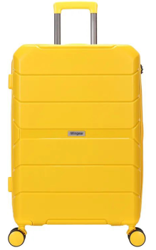
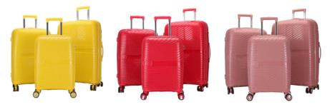
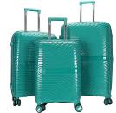
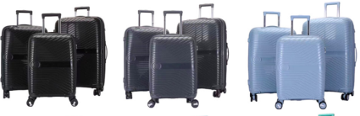
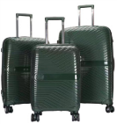
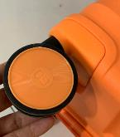
EPP-1290
PP LUGGAGE COLLECTION
14IN//20IN//24IN/28IN
Color matching accessories
Iron trolley
Premium No. 8 Single Zipper
Built-in lock
Silent wheels
210D thicken lining
MOQ: 600 sets

Slide 9
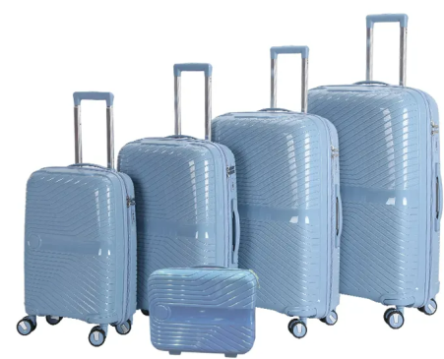

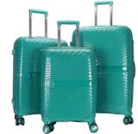
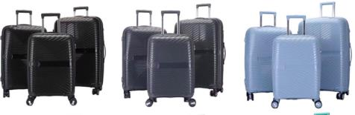

EPP-1191
PP LUGGAGE COLLECTION
14IN//20IN//24IN/28IN/32IN
Color matching accessories
Iron trolley
Premium No. 8 Single Zipper
Built-in lock
Silent wheels
210D thicken lining
MOQ: 600 sets

Slide 10
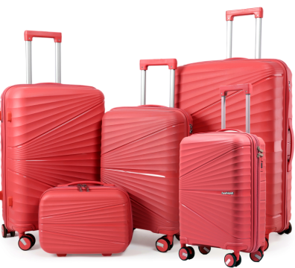
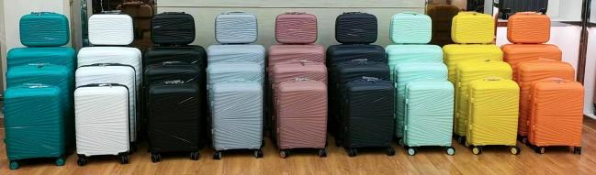
EPP-1292
PP LUGGAGE COLLECTION
14IN//20IN//24IN/28IN/32IN
Color matching accessories
Iron trolley
Premium No. 8 Single Zipper
Built-in lock
Silent wheels
210D thicken lining
MOQ: 600 sets

Slide 11
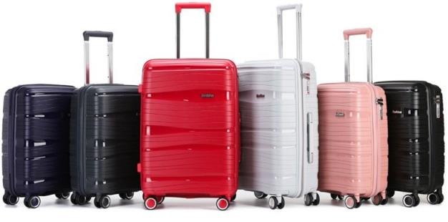
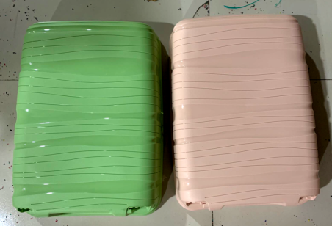
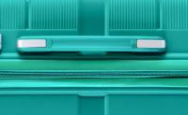
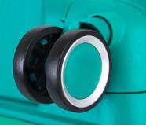
EPP-226
PP LUGGAGE COLLECTION
14IN//20IN//24IN/28IN
Color matching accessories
Iron trolley
Premium No. 8 Single Zipper
Built-in lock
Silent wheels
210D thicken lining
MOQ: 600 sets

Slide 12
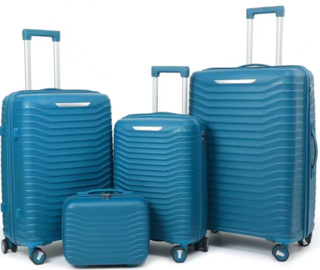
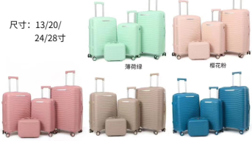
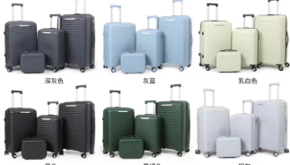
EPP-1294
PP LUGGAGE COLLECTION
14IN//20IN//24IN/28IN
Color matching accessories
Iron trolley
Premium No. 8 Single Zipper
Built-in lock
Silent wheels
210D thicken lining
MOQ: 600 sets

Slide 13
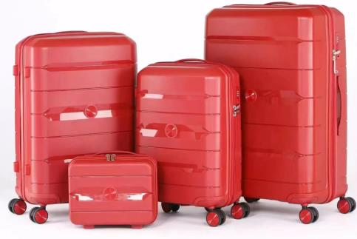
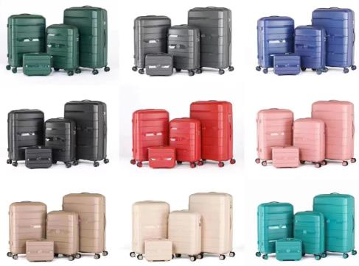
EPP-1295
PP LUGGAGE COLLECTION
14IN//20IN//24IN/28IN
Color matching accessories
IRON trolley
Premium No. 8 Single Zipper
Built-in lock
PP Nylon Silent wheels
210D thicken lining
MOQ: 600 sets

Slide 14
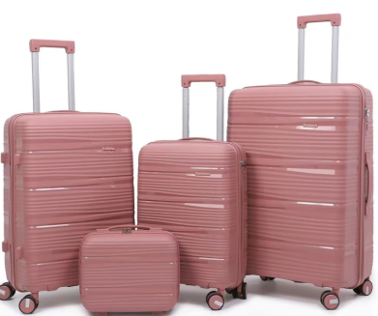
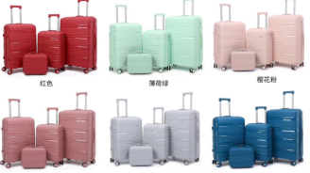
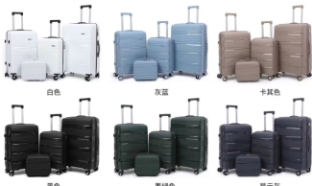
EPP-1296
PP LUGGAGE COLLECTION
14IN//20IN//24IN/28IN
Color matching accessories
Iron trolley
Premium No. 8 Single Zipper
Built-in lock
Silent wheels
210D thicken lining
MOQ: 600 sets

Slide 15
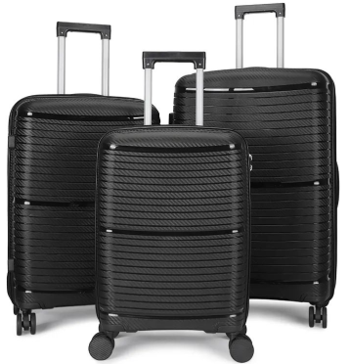
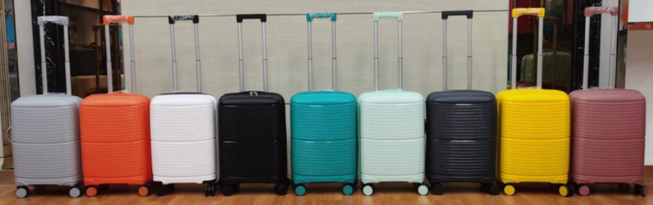

EPP-1297
PP LUGGAGE COLLECTION
14IN//20IN//24IN/28IN
Color matching accessories
Iron trolley
Premium No. 8 Single Zipper
Built-in lock
Silent wheels
210D thicken lining
MOQ: 600 sets

Slide 16
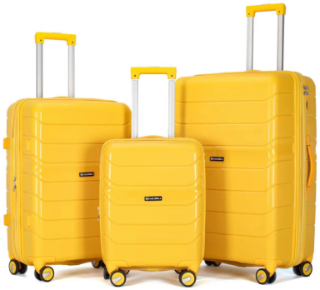
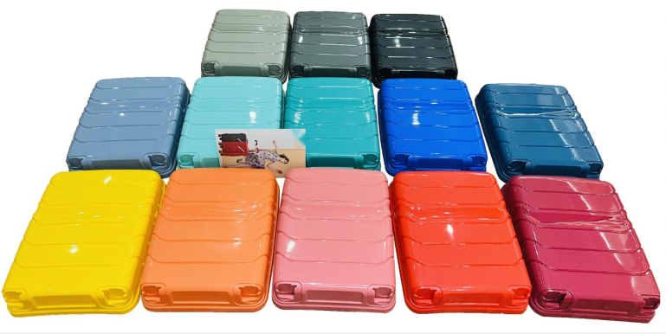
EPP-1298
PP LUGGAGE COLLECTION
14IN//19IN//24IN/28IN
Color matching accessories
Iron trolley
Premium No. 8 Single Zipper
Built-in lock
Silent wheels
210D thicken lining
MOQ: 600 sets

Slide 17



EPP-1299
PP LUGGAGE COLLECTION
21IN//25IN/29IN
Color matching accessories
Iron trolley
Premium No. 8 Single Zipper
Built-in lock
Silent wheels
210D thicken lining
MOQ: 600 sets

Slide 18



EPP-1300
PP LUGGAGE COLLECTION
20IN//26IN/30IN
Color matching accessories
Iron trolley
Premium No. 8 Single Zipper
Built-in lock
Silent wheels
210D thicken lining
MOQ: 600 sets

Slide 19


EPP-1301
PP LUGGAGE COLLECTION
14IN//20IN//24IN/28IN
Color matching accessories
Iron trolley
Premium No. 8 Single Zipper
Built-in lock
Silent wheels
210D thicken lining
MOQ: 600 sets

Slide 20



EPP-1024
PP LUGGAGE COLLECTION
14IN//20IN//24IN/28IN
Color matching accessories
Iron trolley
Premium No. 8 Single Zipper
Built-in lock
Silent wheels
210D thicken lining
MOQ: 600 sets

Slide 21







EPP-1302
PP LUGGAGE COLLECTION
14IN//20IN//24IN/28IN
Color matching accessories
Aluminum trolley
Premium No. 8 Single Zipper
Built-in lock
Silent wheels
210D thicken lining
MOQ: 600 sets

Slide 22



EPP-1303
PP LUGGAGE COLLECTION
20IN//24IN/28IN
Color matching accessories
Aluminum trolley
Premium No. 8 Single Zipper
Built-in lock
Silent wheels
210D thicken lining
MOQ: 600 sets

Slide 23






EPP-1304
PP LUGGAGE COLLECTION
14IN//20IN//24IN/28IN
Color matching accessories
Aluminum trolley
Premium No. 8 Single Zipper
Built-in lock
Silent wheels
210D thicken lining
MOQ: 600 sets

Slide 24

EPP-1305
PP LUGGAGE COLLECTION
14IN//20IN//24IN/28IN
Color matching accessories
Aluminum trolley
Premium No. 8 Single Zipper
Built-in lock
Silent wheels
210D thicken lining
MOQ: 600 sets

Slide 25


EPP-1306
PP LUGGAGE COLLECTION
14IN//20IN//24IN/28IN
Color matching accessories
Aluminum trolley
Premium No. 8 Single Zipper
Built-in lock
Silent wheels
210D thicken lining
MOQ: 600 sets

Slide 26



EPP-1307
PP LUGGAGE COLLECTION
14-18.8-19.6-20.3-21.3-22.4-23.3-24-25-26-27-28-29 in
Color matching accessories Aluminum trolley
Premium No. 8 Single Zipper Built-in lock
Silent wheels
MOQ: 600 sets

Slide 27



EPP-1308
PP LUGGAGE COLLECTION
14-18.8-19.6-20.3-21.3-22.4-23.3-24-25-26-27-28-29 in
Color matching accessories Aluminum trolley
Premium No. 8 Single Zipper Built-in lock
Silent wheels
MOQ: 600 sets

Slide 28







EPP-1309
PP LUGGAGE COLLECTION
14IN/20IN/22IN/24IN/26IN/28IN
Color matching accessories
Aluminum trolley
Premium No. 8 Single Zipper
Built-in lock
Silent wheels
210D thicken lining
MOQ: 600 sets

Slide 29






EPP-1310
PP LUGGAGE COLLECTION
14IN/20IN/22IN/24IN/26IN/28IN
Color matching accessories Aluminum trolley
Premium No. 8 Single Zipper
Built-in lock
Silent wheels
210D Thicken lining
MOQ: 600 sets

Slide 30






EPP-1311
PP LUGGAGE COLLECTION
14IN/20IN/22IN/24IN/26IN/28IN
Color matching accessories Aluminum trolley
Premium No. 8 Single Zipper Built-in lock
Silent wheels
210D Thicken lining
MOQ: 600 sets

Slide 31






EPP-1312
PP LUGGAGE COLLECTION
14IN/20IN/22IN/24IN/26IN/28IN
Color matching accessories Aluminum trolley
Premium No. 8 Single Zipper
Built-in lock
Silent wheels
210D Thicken lining
MOQ: 600 sets

Slide 32






EPP-1313
PP LUGGAGE COLLECTION
14IN/20IN/22IN/24IN/26IN/28IN
Color matching accessories Aluminum trolley
Premium No. 8 Single Zipper
Built-in lock
Silent wheels
210D Thicken lining
MOQ: 600 sets

Slide 33





EPP-1314
PP LUGGAGE COLLECTION
14IN/20IN/22IN/24IN/26IN/28IN
Color matching accessories Aluminum trolley
Premium No. 8 Single Zipper
Built-in lock
Silent wheels
210D Thicken lining
MOQ: 600 sets

Slide 34






EPP-1316
PP LUGGAGE COLLECTION
14IN/20IN/22IN/24IN/26IN/28IN
Color matching accessories Aluminum trolley
Premium No. 8 Single Zipper
Built-in lock
Silent wheels
210D Thicken lining
MOQ: 600 sets

Slide 35





EPP-1316
PP LUGGAGE COLLECTION
14IN/20IN/22IN/24IN/26IN/28IN
Color matching accessories Aluminum trolley
Premium No. 8 Single Zipper
Built-in lock
Silent wheels
210D Thicken lining
MOQ: 600 sets

Slide 36





EPP-1317
PP LUGGAGE COLLECTION
14IN/20IN/22IN/24IN/26IN/28IN
Color matching accessories Aluminum trolley
Premium No. 8 Single Zipper
Built-in lock
Silent wheels
210D Thicken lining
MOQ: 600 sets

Slide 37





EPP-1318
PP LUGGAGE COLLECTION
19IN/23IN/27IN
Color matching accessories Aluminum trolley
Premium No. 8 Single Zipper
Built-in lock
Silent wheels
210D Thicken lining
MOQ: 600 sets

Slide 38






EPP-1319
PP LUGGAGE COLLECTION
21IN/25IN/29IN
Color matching accessories Aluminum trolley
Premium No. 8 Single Zipper
Built-in lock
Silent wheels
210D Thicken lining
MOQ: 600 sets

Slide 39





EPP-1320
PP LUGGAGE COLLECTION
20IN/24IN
Color matching accessories Aluminum trolley
Premium No. 8 Single Zipper
Built-in lock
Silent wheels
210D Thicken lining
MOQ: 600 sets

Slide 40






EPP-1321
PP LUGGAGE COLLECTION
20IN/24IN/28IN
Color matching accessories
Aluminum trolley
Premium No. 8 Single Zipper
Built-in lock
Silent wheels
210D Thicken lining
MOQ: 600 sets

Slide 41






EPP-1322
PP LUGGAGE COLLECTION
20IN/24IN/28IN
Color matching accessories Aluminum trolley
Premium No. 8 Single Zipper
Built-in lock
Silent wheels
210D Thicken lining
MOQ: 600 sets

Slide 42






EPP-1323
PP LUGGAGE COLLECTION
20IN/24IN/28IN
Color matching accessories
Aluminum trolley
Premium No. 8 Single Zipper
Built-in lock
Silent wheels
210D Thicken lining
MOQ: 600 sets

Slide 43






EPP-1324
PP LUGGAGE COLLECTION
20IN/24IN/28IN
Color matching accessories
Aluminum trolley
Premium No. 8 Single Zipper
Built-in lock
Silent wheels
210D Thicken lining
MOQ: 600 sets

Slide 44






EPP-1325
PP LUGGAGE COLLECTION
20IN/24IN/28IN
Color matching accessories Aluminum trolley
Premium No. 8 Single Zipper
Built-in lock
Silent wheels
210D Thicken lining
MOQ: 600 sets

Slide 45



EPP-1326
PP LUGGAGE COLLECTION
20IN/24IN/28IN
Color matching accessories Aluminum trolley
Premium No. 8 Single Zipper
Built-in lock
Silent wheels
210D Thicken lining
MOQ: 600 sets

Slide 46

Thank you.

